Slide 1

Each hackathon project will be built around a specific theme - a focus area that outlines the kind of problems you’ll be solving and the impact your solution aims to create. Themes are designed to help guide your creativity, give structure to your ideas, and ensure your project is aligned with the overall goals of the event.
Your final project will be evaluated by a panel of judges who are experts in that theme’s domain. A strong alignment between your project and your chosen theme can significantly boost your score, as it shows you’ve understood the problem space, used relevant insights, and tailored your solution to the needs and opportunities in that area.
In short:
Themes help you focus your ideas.
Judges are specialists in the theme you choose.
The closer your solution matches the theme’s goals, the better your chances of impressing the panel.

Slide 2
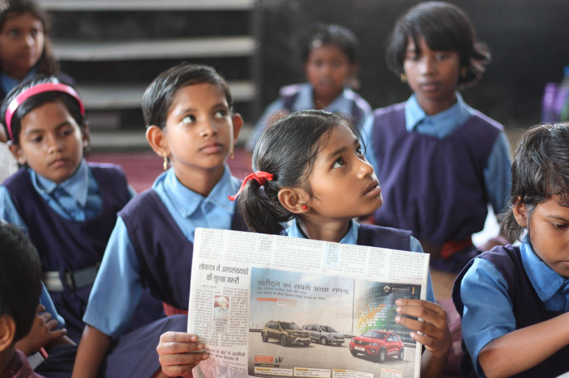
Economic Empowerment
Enable and empower underrepresented populations to overcome poverty through improved access to education, increased economic opportunities, and to realize decent work for all

Slide 3
Table of Contents
1
Executive Summary
Overview
Relevant SDGs
Subthemes
Examples
… 04
… 05
… 06
… 07
… 13
2
3
4
5

Slide 4

Executive Summary
Enable and empower underrepresented populations to overcome poverty through improved access to education, increased economic opportunities, and to realize decent work for all
Key UN SDGs: SDG 1: No Poverty, SDG 4: Quality Education, SDG 5: Gender Equality, SDG 8: Decent Work and Economic Growth, SDG 10: Reduced Inequalities
Subthemes:
Trade and Development
DEI & Wage Gap
Universal Coverage
Quality Basic Education
International Investment Dynamics

Slide 5
Overview
Rapid growth has lifted millions out of poverty, but progress has been uneven. Women are often held back more than men due to lack of access to paid work and education. Progress has been limited in regions like South Asia and sub-Saharan Africa, which account for 80 percent of those living in extreme poverty. New threats brought on by climate change, conflict and food insecurity, cement this need. The use of finite resources is a topic covered by the economic aspects of development.
How can we provide economic liberation for everyone? And Can we urgently collaborate and find solutions to such an important need?

Slide 6
UN SDGs
Economic Empowerment: UN SDGs
#1: No Poverty
#4: Quality Education
End poverty in all its forms everywhere.
Ensure inclusive and equitable quality education and promote lifelong learning opportunities for all.
#5: Gender Equality
Achieve gender equality and empower all women and girls.
#8: Decent Work and Econ. Growth
Promote sustained, inclusive and sustainable economic growth, full and productive employment and decent work for all.
#17: Partnership for the Goals
Mobilising resources to foster macroeconomic stability for developing countries from international sources

Slide 7
Subthemes

Slide 8
Trade and Development
Economic Empowerment: Trade and Development
“Nowadays one country cannot go it alone. This is a global village.” - Sheikh Hasina
Trade and Development: Trade has been a part of economic development for centuries. It has the potential to be a significant force for reducing global poverty by spurring economic growth, creating jobs, reducing prices, increasing the variety of goods for consumers, and helping countries acquire new technologies. (The Swedish International Development Cooperation Agency)
Did you know?
“The 2030 Agenda for Sustainable Development defines international trade as “an engine for inclusive economic growth and poverty reduction, [that] contributes to the promotion of sustainable development” (UNCTAD)
See Modern Technological Innovations
The World Bank - The Importance of Trade to Development
The 2030 Agenda for Sustainable Development

Slide 9
DEI & Wage Gap
Economic Empowerment: DEI & Wage Gap
“When we pay women less than men, we’re telling women their work isn’t as valuable. We’re all equally valuable. And we should be paid equally.” – Maria Shriver, Journalist
DEI & Wage Gap: Diversity, equity and inclusion (DEI) is a term used to describe policies and programs that promote the representation and participation of different groups of individuals, including people of different ages, races and ethnicities, abilities and disabilities, genders, religions, cultures and sexual orientations. (TechTarget for HR Professionals)
Did you know?
“On average, racialized women make 59.3% of a white man’s earnings”
Only 16% of women and gender diverse people with a physical disability report being fairly paid compared to their peers” (Canadian Women’s Foundation)
See Modern Technological Innovations
The Pandemic and the Gender Pay Gap in 2022
Pay Transparency is Critical to DEI Initiatives

Slide 10
Universal Coverage
Economic Empowerment: Universal Coverage
“The truth is, in order to get things like universal health care and a revamped education system, then someone is going to have to give up a piece of their pie so that someone else can have more.” – Michelle Obama, Former First Lady of the United States
Universal Coverage: Universal health coverage means that all people have access to the full range of quality health services they need, when and where they need them, without financial hardship. (World Health Organization)
Did you know?
“The UHC service coverage index (SDG indicator 3.8. 1) increased from 45 in 2000 to 67 in 2019, but 30% of the world's population still cannot access essential health services. Moreover, almost 2 billion people are facing catastrophic or impoverishing health spending (SDG indicator 3.8.”(World Health Organization)
See Modern Technological Innovations
Healthy life expectancy in Africa grows by nearly 10 years
WHO calls for action to provide migrant and refugee healthcare

Slide 11
Quality Basic Education
Economic Empowerment: Quality Basic Education
“Education is the most powerful weapon which you can use to change the world.” – Nelson Mandela, First President of South Africa
Quality Basic education: Quality basic education refers to formal, non-formal, and informal public and private activities intended to meet the basic learning needs of people of all ages. It includes instruction at the first or foundation level, on which subsequent learning can be based, encompassing early childhood and primary (or elementary) education for children, as well as education in literacy, general knowledge, and life skills for youth and adults. (Inter-agency Network for Education in Emergencies )
Did you know?
“Around 90 percent of the world's population had completed a primary education in 2020, whereas only 66 percent had attained a secondary education.” (Statista)
See Modern Technological Innovations
Access to Education - Almost 50 million of Children of Primary School Age are not in School

Slide 12
International Investment Dynamics
Economic Empowerment: International Investment Dynamic
“International investment is so important because it makes economic globalisation and the growth and jobs it brings possible. Investment provides the finance needed to build value chains that stretch across the planet. It facilitates the trade that allows goods and services to be moved to where they are needed.” - Ana Novik, Head of OECD Investment
International Investment: International investing is an investment strategy that involves selecting global investment instruments as part of an investment portfolio. (BlackRock)
Did you know?
“The United States recorded the largest increase of inward foreign direct investment of all economies in 2021. The latest release of the IMF’s Coordinated Direct Investment Survey shows the US position increasing by $506 billion, or 11.3 percent, last year.”(IMF Blog)
See Modern Technological Innovations
Trends and Benefits of Foreign Investments
How International Investment Is Shaping the Global Community

Slide 13
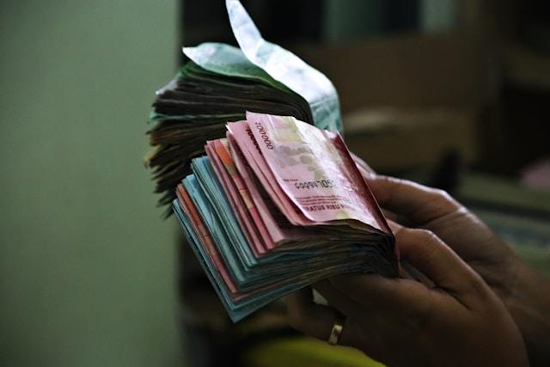
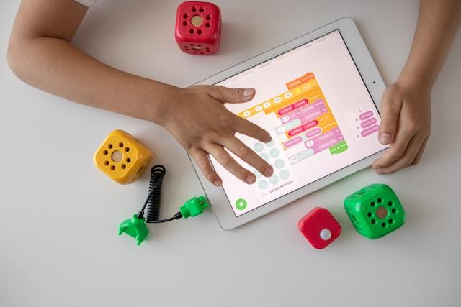
Examples from Previous Hack the Globe Winners
https://globalspark.world/hacktheglobe
Ethical Microloans (2025 – 3rd Place)
AdaptEd (2023 – 2nd Place)
A marketplace connecting ethical investors with micro-entrepreneurs to reduce capital access barriers.
An AI-powered education platform supporting students with learning disabilities.

